Slide 1
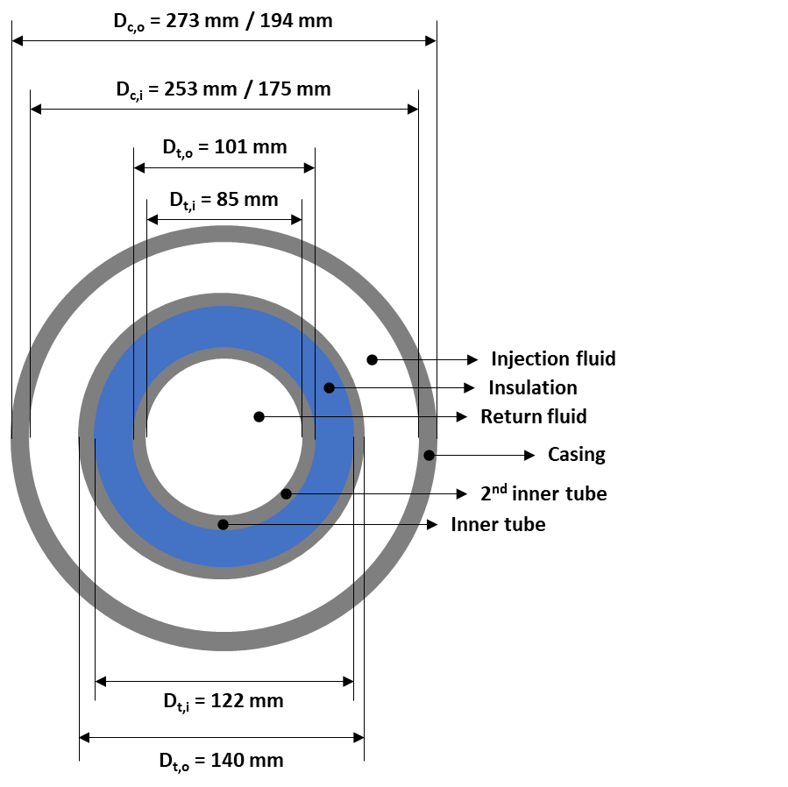
Task 2.2-2.3: Well models (IFE, IFPEN, UNIFI, RW)
Water properties: PT dependant
Injection pressure: 10 bar
Surface temperature: 15°C
Domain radius: 50 m
Rocks properties: ρ_{r} = 2600 kg/m³, Cp_{r} = 900 J/kg/K
Casing and tubing properties: : ρ_{c} = 7850 kg/m3, Cp_{c} = 466 J/kg/K, k_{c} = 50 W/m/K
Fluid model activated
Fully cased, not cemented
Basic case (red squares): Simulated with GTW (IFE), GWellFM (IFPEN) & BHEModel (UNIFI)
Time: t_{min} – 20 years
Report:
Temporal evolution (for all time steps) of outlet pressure, temperature, enthalpy difference, power (P, T, ΔH, Q vs. t)
Spatial evolution of fluid’s pressure, temperature with the distance along the casing and tubing (P_{f}, T_{f} vs. l) at 1, 7, 15, 30, 60, 90, 180, 365, 730, 1825, 3650, 7300 days
Temporal (at above time steps) and spatial (profile along the wellbore) rock’s temperature at 1, 5, 10, 20, 30 m from the horizontal well
Injection |  | Geometry |  | Insulation |  | Casing |  |  |  | Rocks
Flow rate v [l/s] | Injection temperature T [°C] | Depth D [km] | Length L [km] | Material k_{i} [W/m/K] | Thickness e [mm] | Diameter (vertical) d_{V} [mm] |  | Diameter (horizontal) d_{H} [mm] |  | Gradient g_{T} [°C/km] | Conductivity (vertical) k_{r} [W/m/K] | Conductivity (horizontal) k_{r} [W/m/K]
 |  |  |  |  |  | OD | ID | OD | ID
5 | 25 | 2 | 3 | 0.01 | 5 | 248 | 217 | 178 | 159 | 20 | 1.4 | 2
7.5 | 30 | 3 | 5 | 0.1 | 10.5 | 273 | 253 | 194 | 175 | 30 | 2 | 3
10 | 35 | 4 | 7 | 1 | 15 | 298 | 271 | 219 | 201 | 40 | 3 | 5
GTW (IFE)
GWellFM (IFPEN)
BHEModel (UNIFI)

Slide 2
Task 2.2-2.3: Well models (IFE, IFPEN, UNIFI, RW)
Injection |  | Geometry |  | Insulation |  | Casing |  |  |  | Rocks
Flow rate v [l/s] | Injection temperature T [°C] | Depth D [km] | Length L [km] | Material k_{i} [W/m/K] | Thickness e [mm] | Diameter (vertical) d_{V} [mm] |  | Diameter (horizontal) d_{H} [mm] |  | Gradient g_{T} [°C/km] | Conductivity (vertical) k_{r} [W/m/K] | Conductivity (horizontal) k_{r} [W/m/K]
 |  |  |  |  |  | OD | ID | OD | ID
5 |  | 2 | 3 | 0.01
7.5 | 30 | 3 | 5 |  | 10.5 | 273 | 253 | 194 | 175 | 30 | 2 | 3
10 |  | 4 | 7
GTW (IFE)
Injection |  | Geometry |  | Insulation |  | Casing |  |  |  | Rocks
Flow rate v [l/s] | Injection temperature T [°C] | Depth D [km] | Length L [km] | Material k_{i} [W/m/K] | Thickness e [mm] | Diameter (vertical) d_{V} [mm] |  | Diameter (horizontal) d_{H} [mm] |  | Gradient g_{T} [°C/km] | Conductivity (vertical) k_{r} [W/m/K] | Conductivity (horizontal) k_{r} [W/m/K]
 |  |  |  |  |  | OD | ID | OD | ID
5 |  |  |  | 0.01 | 7.5 | 248 | 217 | 178 | 159 |  | 1.4 | 2
 | 30 |  | 5 |  | 10.5 | 273 | 253 | 194 | 175 | 30 | 2 | 3
 |  | 4 |  |  | 12.5 | 298 | 271 | 219 | 201 |  | 3 | 5
GWellFM (IFPEN)
Injection |  | Geometry |  | Insulation |  | Casing |  |  |  | Rocks
Flow rate v [l/s] | Injection temperature T [°C] | Depth D [km] | Length L [km] | Material k_{i} [W/m/K] | Thickness e [mm] | Diameter (vertical) d_{V} [mm] |  | Diameter (horizontal) d_{H} [mm] |  | Gradient g_{T} [°C/km] | Conductivity (vertical) k_{r} [W/m/K] | Conductivity (horizontal) k_{r} [W/m/K]
 |  |  |  |  |  | OD | ID | OD | ID
5 |  |  |  | 0.01 |  |  |  |  |  | 20
 | 30 |  | 5 | 0.1 | 10.5 | 273 | 253 | 194 | 175 | 30 | 2 | 3
 |  | 4 |  | 1 |  |  |  |  |  | 40
BHEModel (UNIFI)

Slide 3
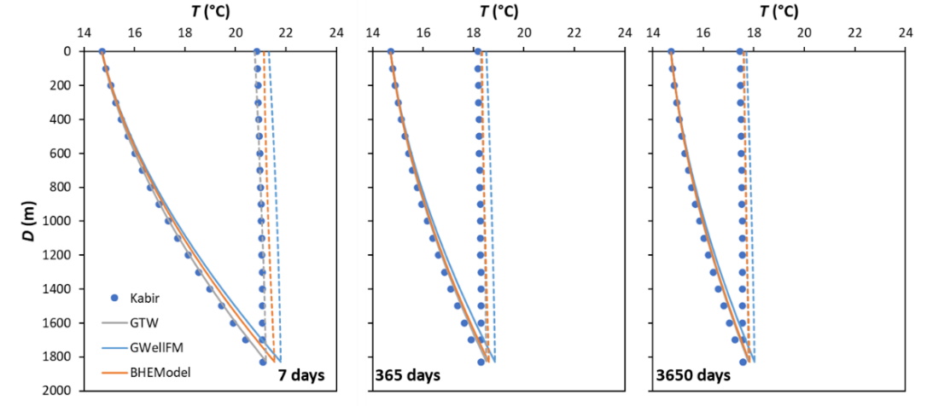
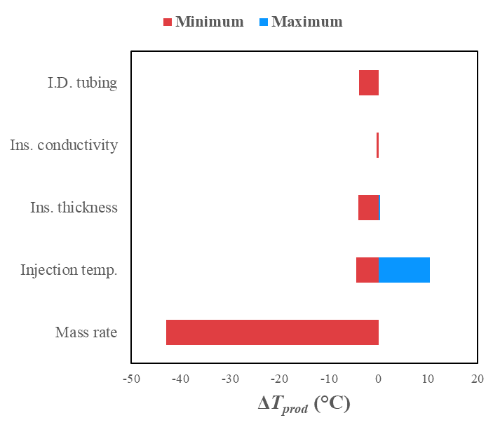
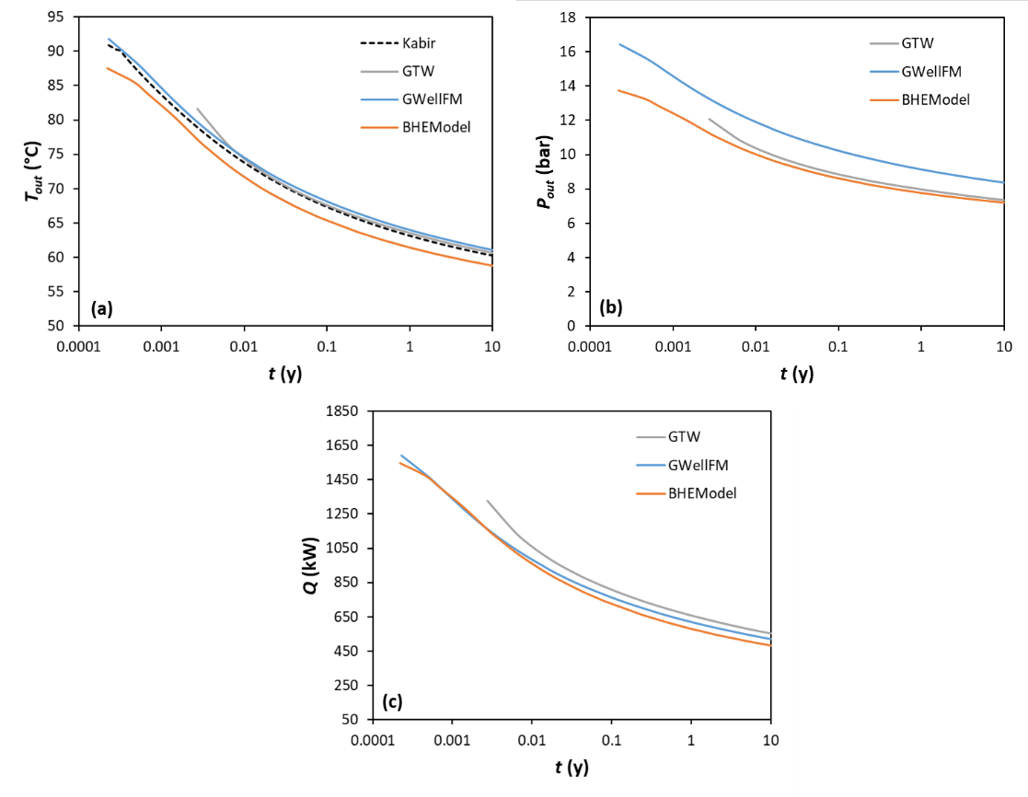
Task 2.2-2.3: Well models (IFE, IFPEN, UNIFI, RW)
Tornado diagrams

